Slide 1
AL Nokhba
Admin & Mobile Application
This project is to build a role-based mobile app for lawyers and users with service requests, payments, and admin control.

Slide 2
Table of contents
01 Introduction
02 Project Objective
03 Target Users
04 Key Features
05 TechStack
06 Project TimeLine
07 Project Costing

Slide 3
Introduction
AL Nokhba is a secure app connecting lawyers with users for chat, call, and video consultations. Users request services and upload documents, while lawyers manage requests and share files. Wallet payments are supported, and admins oversee users, pricing, transactions, and feedback through a dashboard.

Slide 4
Project Objective
Enhance Accessibility
Ensure Transparency
Streamline Communication
Promote Security and Improve
Service Quality

Slide 5



Target Users
End User(Individuals & Companies)
Lawyers
Admins

Slide 6
End User’s
Lawyer’s
Admin’s
Key Features
- Lawyer’s Authentication
(Username & Password)
- Profile
- Home
- Service(Consultation)
- Notification and Alerts
- Dashboard
- Admin Management
- Lawyer Management
- End User Management
- Service Management
- Notification & Alerts
- Reports
- Support
- Transaction Management
- User Authentication(Phone no and Password)
- Profile
- Home
- My Consultation
- My Wallet
- Notifications and Alerts

Slide 7
TechStack
Department | Tools and Technology
Project Management | Google Workspace(For documents and files), Clickup(For task management)
Tech and Database | TypeScript, NodeJS, Flutter, Apollo GraphQl, PostgreSQL, Redis
Infra | AWS and Service(Backend & Admin), S3(File Storage), AWS Cloudfront(CDN)
Mail and SMS(Auth) | AWS SES / Zepto by Zoho, Twilio Verify
Analytics | GA4
Error Tracking | Sentry
Payment | TBD (Will be provided by client)
Call and Video | Agora
Pusher | Realtime chat
Notification and Crashytics | Onesignal, Firebase

Slide 8
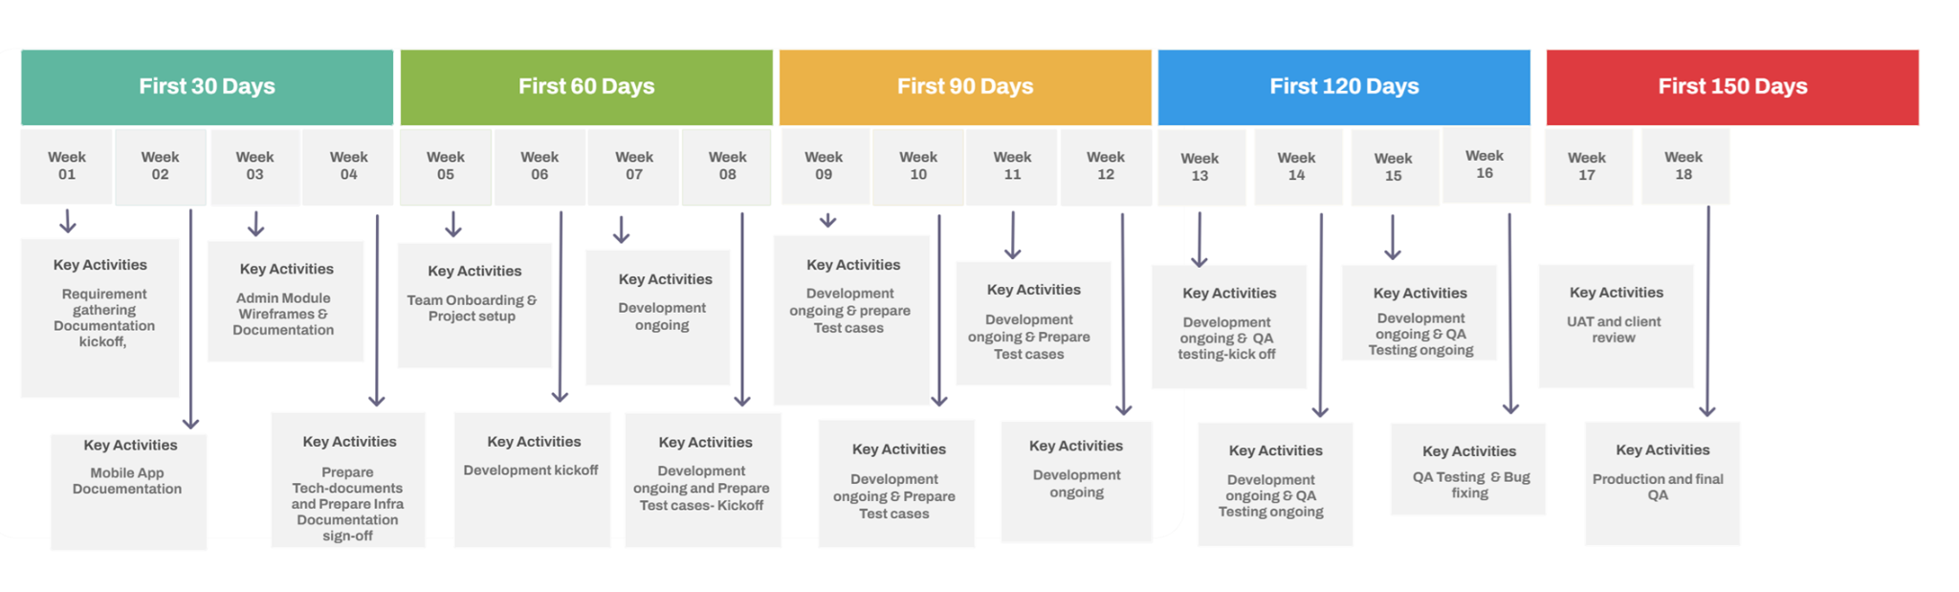
Project Timeline

Slide 9
Project Costing
TimeLine
Costing
4.5 Months
$40,000

Slide 10




Target Users
Lessor
Lessee
Admin(Head Office)
Franchise / City Partner

Slide 11



Target Users
Vendors
CRM/Support Team
Legal Head/Compliance
Investor

Slide 12
Thank You.

